Slide 1

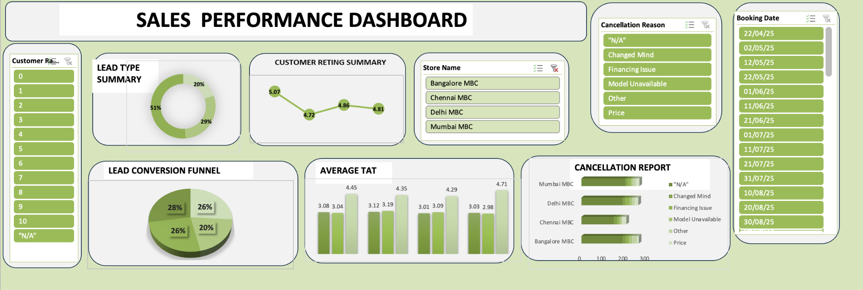
ElectricPe Operational Analysis
Excel Dashboard Insights

Slide 2
Key Metrics Overview
KPI | Value | Comment
Total Leads | 1002 | Strong lead generation
Booking Conversion | 99.8% | Excellent conversion performance
Delivery Rate | 100% | Efficient fulfillment
Cancellation Rate | 27.05% | Needs improvement
Follow-up Completion | 72.9% | Moderate — gaps in engagement
Avg Booking TAT (Days) | 3.07 | Fast processing
Avg Delivery TAT (Days) | 4.46 | Slight delay scope
Avg Customer Rating (1–10) | 4.85 | Moderate satisfaction level
---------------------------------------------------------------
Insights & Bottlenecks
🔹 High cancellations (27%) → possibly due to model unavailability or expectation mismatch.
🔹 Low satisfaction (4.85/10) → signals service or communication issues.
🔹 Follow-up rate (72.9%) → ~1 in 4 customers not followed up after delivery.
🔹 Delivery TAT (4.46 days) → scope to optimize routes and logistics.

Slide 3
Recommendations & Business Impact
Recommendations
Lead Conversion → Maintain predictive lead scoring to sustain ~99%+ conversion.
Delivery TAT → Optimize logistics and routing to cut delivery time by 15–20%.
Service Follow-ups → Automate reminders and integrate a follow-up dashboard.
Cancellation Reduction → Analyze reasons and re-target dropped customers.
Customer Satisfaction → Introduce post-service surveys and quick issue resolution.
Impact Summary
📈 Expected Results:
Reduce cancellations by ~10%
Improve average customer rating from 4.8 → 7+
Increase follow-up completion rate to >90%
Enhance overall operational efficiency and brand trust

Slide 4
Conclusion :
Our data reveals strong conversion and delivery efficiency, but notable challenges in customer retention and post-delivery satisfaction. Addressing these can unlock higher loyalty and operational excellence.
By tightening post-sales processes and optimizing logistics, we can drive measurable impact — higher customer satisfaction, fewer cancellations, and faster delivery cycles.
Implementing the above recommendations can help in improving efficiency and customer satisfaction across all stores

